Slide 1
COMP6230: Implementing Cybersecurity
Oli Bills
ofb@ecs.soton.ac.uk

Slide 2
Coming up…
What is cybersecurity?
Security issues and threats
Risks and planning
The basic principles of security
Policies, mechanisms, detection, prevention
What are we up against?
Know your enemy
Getting security right

Slide 3
But before we begin…
Setting the context of our new cyber world…

Slide 4
If this is the answer…
Sponsored by…
What was the question?

Slide 5
3.2 billion
Estimated internet users

Slide 6
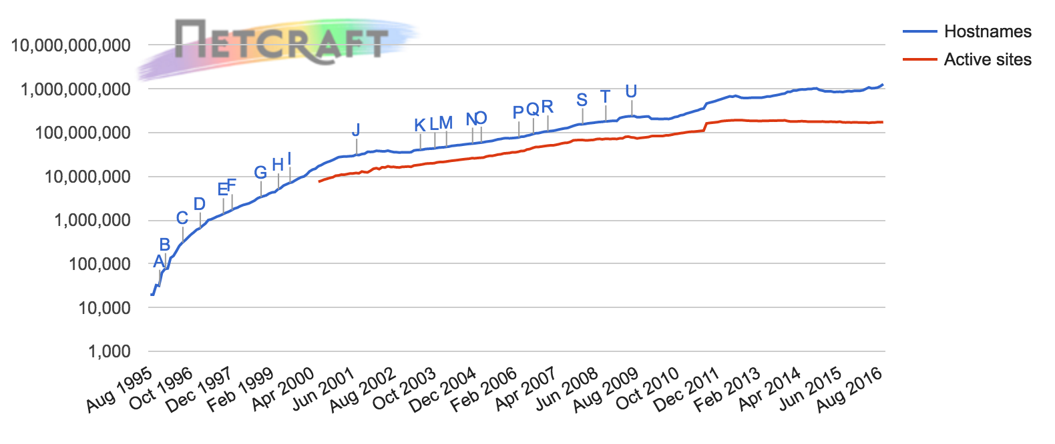
Things are going up… and fast!

Slide 7
20 million
Mobile malware apps

Slide 8
19%
Sites powered by Wordpress

Slide 9
320 Hours
Longest hactivism DDOS attack in 2015

Slide 10
Wordpress
Never the answer to anything!

Slide 11
What is cybersecurity?
Detection, protection and prevention against digital threats and attacks
Technologies, Procedures, People
The entire digital ecosystem

Slide 12
What kinds of threats?
eavesdropping (or visual surveillance)
wiretapping (= keyboard logging)
key interception
impersonation (person, address, computer) • data duplication
cryptanalysis
social engineering
physical security
malware
exploiting software vulnerabilities
combinations of different attacks
Just to name a few!

Slide 13
Who do they affect?
National security and infrastructure
Government and public bodies
The economic processes and banking systems
The everyday citizen
You!

Slide 14
And where do they come from?
Criminal
Competitor
Hacker
Government
Terrorist
Ethical hacker
Former employee
Employee
Customer
Contractor
Whistleblower
Everybody?

Slide 15
A few things to remember…
We are building fences not walls
You can lock the door, but it’s no good if the window is open
A secure system is only as strong as it’s weakest link
And that could be you…

Slide 16
Cybersecurity education is an emergency
We shouldn’t be in this position…
But we are
And we’ve got to do our best to save ourselves
And probably the world...

Slide 17
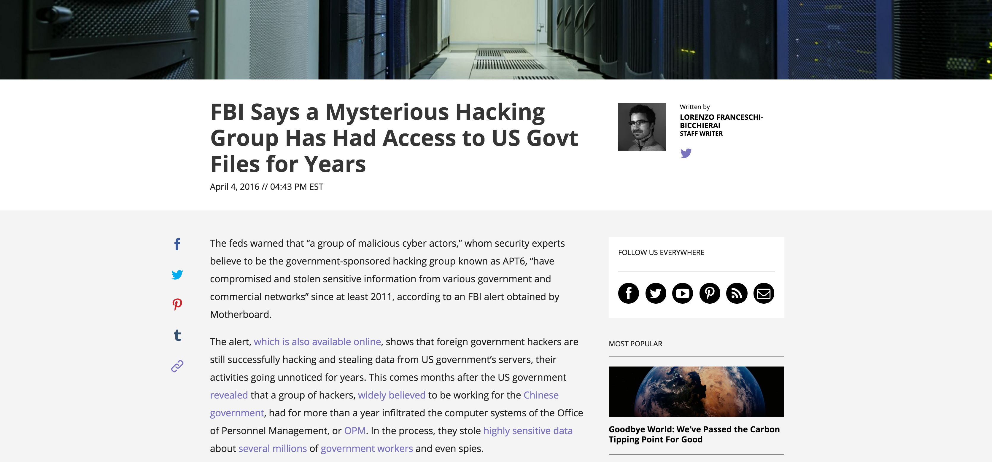
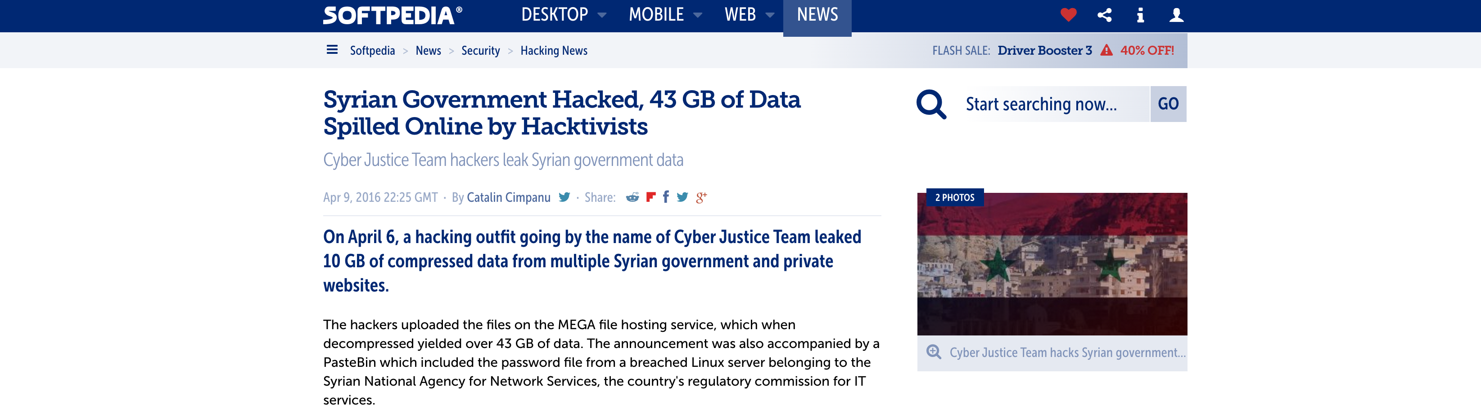
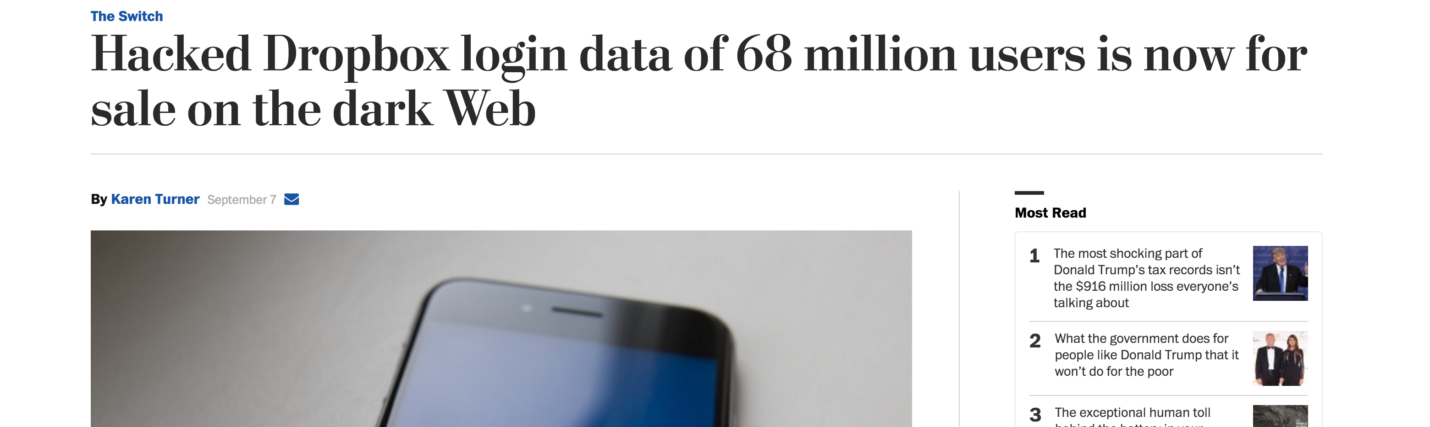

Slide 18
What does the future hold?
More extortion
It works…
The Internet of Things
We’ve seen the proofs of concepts
It’s coming…
Home appliances, vehicles, medicine, assistants
It’ll be less obvious
Changing and manipulating, not deleting and releasing
Backdoors
Including from the people we “trust”

Slide 19
What does the future hold?
More users of more technologies
The Tablet era
Next up: The assistant era
Digital replacing physical
Why go to the issues of dealing with chip and pin
When you can just buy a card number and use it online...
Or even just a payment account

Slide 20
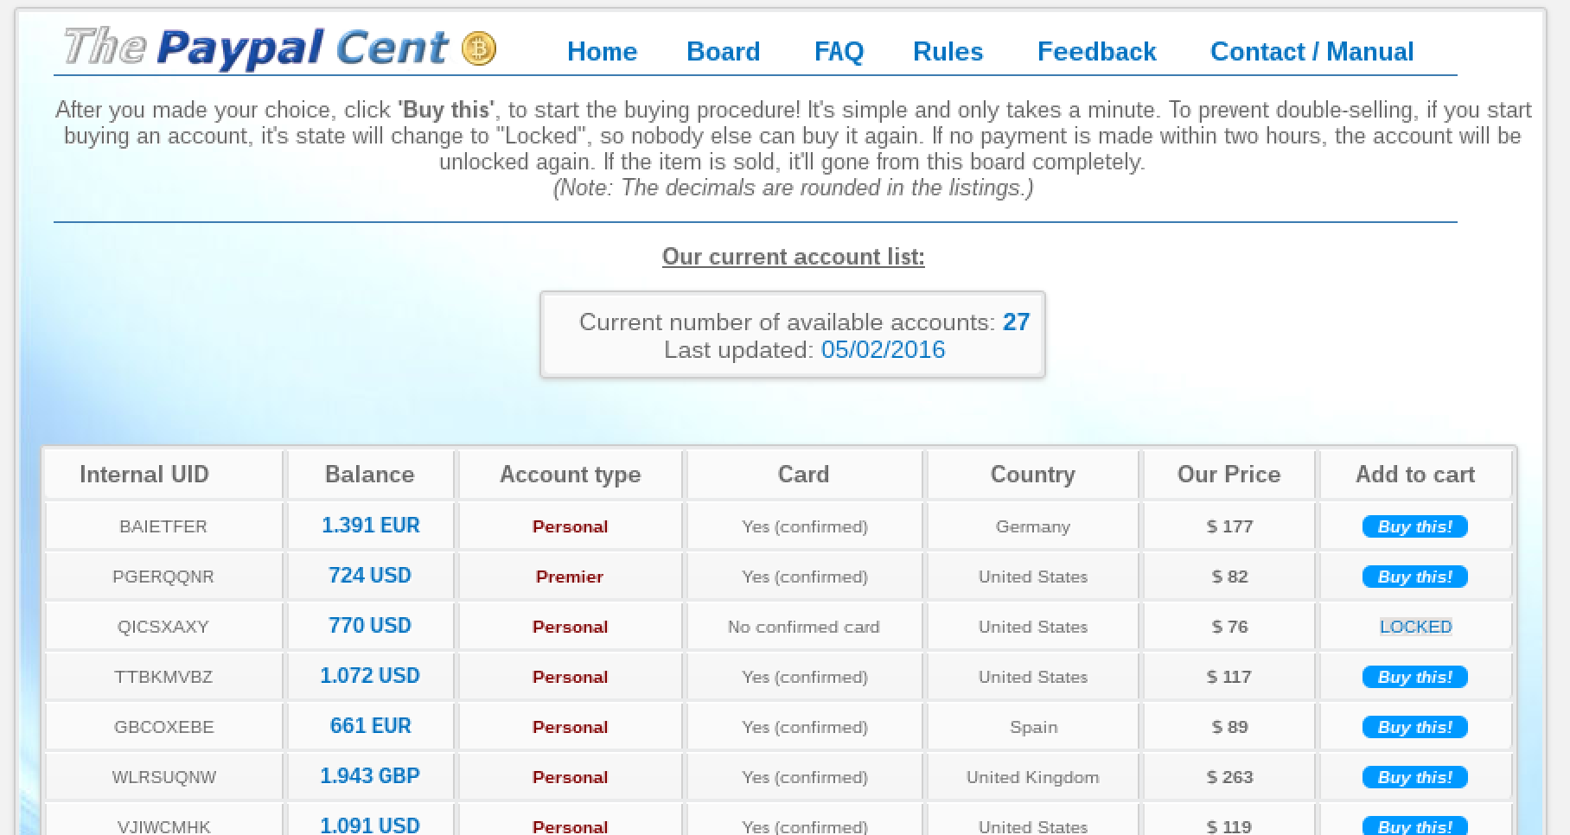
Digital Account Theft
It’s a gamble… but a better return on investment than a 0.9% savings account?

Slide 21
How do we deal with threats?
Risk management
Risk: Probability that an adverse circumstance will occur
Risk management
Analysing the risks
What would the impact be?
What are the probabilities?
Controlling the risks
Avoidance: Don’t let it occur
Minimisation: Minimise the chance of it occuring
Contingency: If it does occur

Slide 22
How do we deal with threats?
Security policies
How to keep a system secure
Achieved through security mechanisms
We need to do better than we do now
Cybersecurity issues have become the norm…

Slide 23
Security Policies
What do we want to ensure?
Confidentiality
Integrity
Availability
Authenticity

Slide 24
Security Mechanisms
To achieve or enforce security policy
Aims:
Prevention
Detection

Slide 25
Prevention Examples
Authentication
Authorisation and role-based access control
Encryption
Firewalls
Network segmentation
Backups
Updates and patches
Training and education

Slide 26
Detection Examples
Hashes
Digital signatures
Intrusion detection systems
Malware/antivirus scanning
Monitoring systems
Honeypots
Training and education
Disclosure policies

Slide 27
Typical Components of Security Mechanisms
Identification
Authentication
Authorization
Physical protection
Cryptography: Hard maths!
Randomness
Economics
Deception

Slide 28
Backups are good…
This is not what you want to see when you’ve forgot to set up backups for a year…
Estimated around 40,000 per month infections of ransomware
Cryptolocker alone expected to have raised over $30,000,000 in 2013
43% of users in a survey said they had paid the fine!

Slide 29
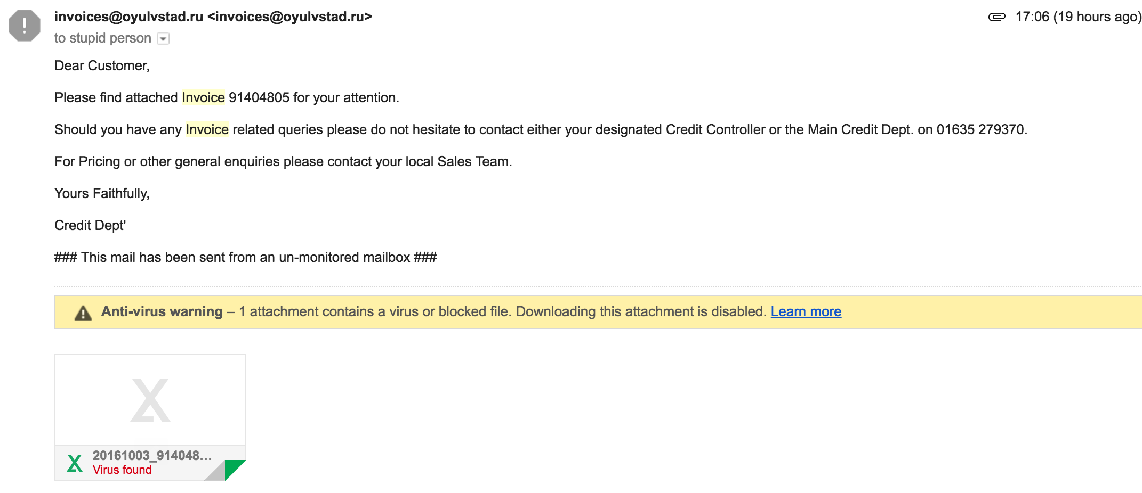
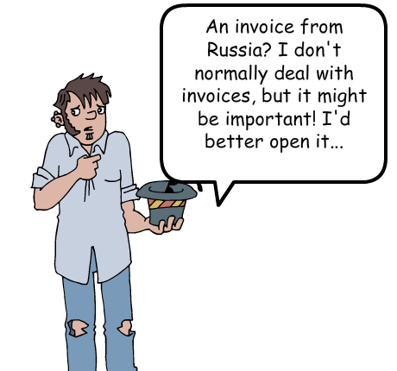
Training and education
Your users are either with you
Or against you…

Slide 30
Getting security right
Don't make assumptions
Don't be a perfectionist
Remember your users of the system
Don't be overzealous
Two steps forward, one step back
Post-it note example
Build up your layers of security

Slide 31
Getting security right
But be realistic
Keep it simple
KISS
Education is important
Don't keep secrets
Security through obscurity is evil
Be open
Engage with your users
Encourage disclosure

Slide 32
Getting security right
Keep your weakest link strong
It's like playing Ingenious
Each turn, you place a tile, with 2 colours on it, with at least one of those colours touching another tile of it’s colour
You gain colour points for each coloured tile in a line that matches the colour
Your score is equal to the colour points of your lowest colour
Just as in cybersecurity, your score is your weakest part of the system

Slide 33
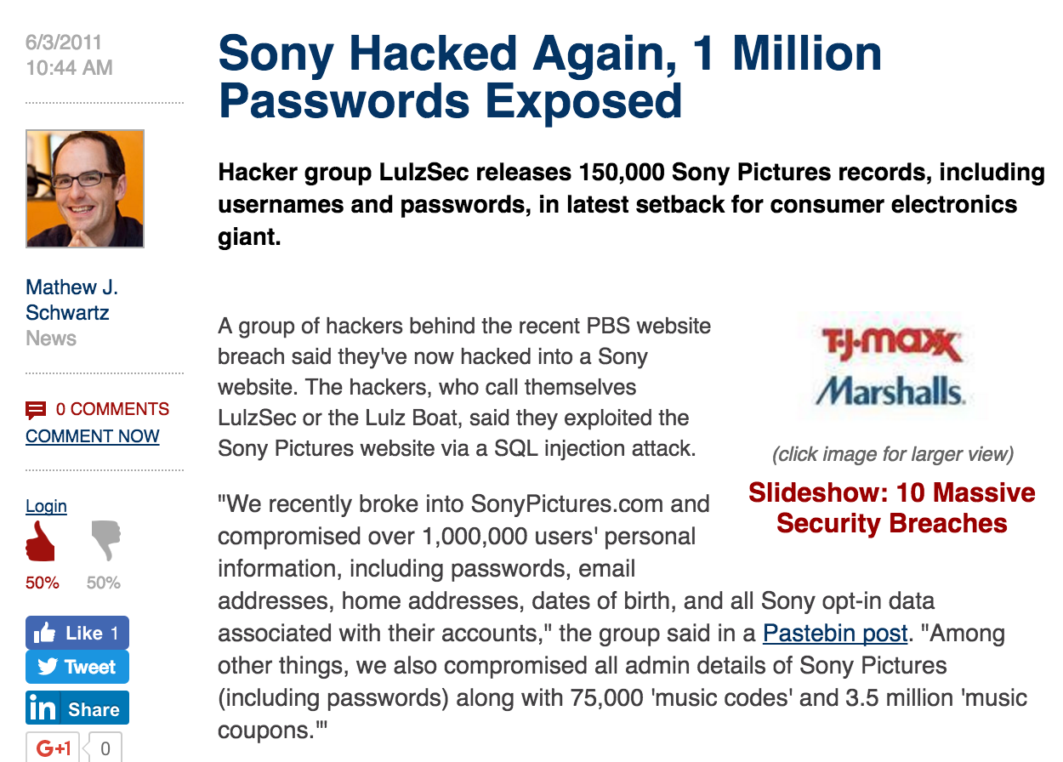
That one weak chain
For example, Sony lost 1 million customer passwords and details due to a single SQL injection vulnerability on their website

Slide 34
The problem with industry
They often know their systems are insecure
But it’s not a priority
It goes at the bottom of the to-do list
Security is only important when it's too late
You lose all your customers details, and then you try to deal with it
Security is an afterthought
You shouldn’t make the problem in the first place
Security through obscurity

Slide 35
The industry flow diagram
Business as usual
Vulnerability is found
Vulnerability is exploited
People get angry and/or bankrupt
Goes into a black hole somewhere

Slide 36
The industry flow diagram
Business as usual
Vulnerability is found
Vulnerability gets fixed
£

Slide 37
The industry flow diagram
Business as usual
Vulnerability is found
Vulnerability is exploited
People get angry and/or bankrupt
£
Goes into a black hole somewhere

Slide 38
Cybersecurity in the UK
Cyber security standards
Business can work with these standards to better protect themselves
Further reading
http://www.bsigroup.com/en-GB/Cyber-Security/Cyber-security-for-SMEs/Standards-for-IT-and-cyber-security/#Gov-standards
http://www.itgovernance.co.uk/cybersecurity-standards.aspx

Slide 39
ISO/IEC 27001: Information Technology
The international Standard for best-practice information security management systems
Covers
Protecting and preserving information under:
Confidentiality
Availability
Integrity
Best practices
Allows for externally assessed certified compliance

Slide 40
ISO/IEC 27032: Guideline for cybersecurity
International Standard focussing explicitly on cyber security
Consideration of cybersecurity threats and attack vectors
Guidelines for protecting information outside an organisation
Dealing with clients and suppliers

Slide 41
Various others
ISO/IEC 27031 — Guidelines for information and communication technology readiness for business continuity
ISO/IEC 27033-1 — Network security - Part 1: Overview and concepts
ISO/IEC 27033-2 — Network security - Part 2: Guidelines for the design and implementation of network security
ISO/IEC 27033-3 — Network security - Part 3: Reference networking scenarios - Threats, design techniques and control issues
ISO/IEC 27033-5 — Network security - Part 5: Securing communications across networks using Virtual Private Networks (VPNs)
ISO/IEC 27034-1 — Application security - Part 1: Guideline for application security
ISO/IEC 27035 — Information security incident management

Slide 42
How could the university be attacked?
Who might attack it?
How might they attack it?
What weaknesses does the university have?
As an insider, what information do you know that could help you?

Slide 43
Any questions?

